Slide 1
Select Neighborhood in Toronto to Open New Restaurant
Coursera Capstone

Slide 2
Introduction
Business Problem:
For restaurants to be successful, location is one of the most determining factors. A good location can bring foot traffic to a new restaurant, which is crucial in the early stages. Location is also a factor that is difficult/costly to change in the future, so it is very important for the business owner to make an informed, calculated decision.
Target Audience:
This project aims to help business owners to select the most appropriate neighbourhood to open a new restaurant in the city. Toronto will be used for demonstration.

Slide 3
Dataset
To measure these two factors, we will use the following metrics:
1. List of Toronto neighbourhoods, which we will extract from Wikipedia
2. Postal codes, Latitudes and longitudes of each neighbourhood, which we can get from the csv file provided in previous week's assignment
We will then retrieve the following data using Foursquare API
3. number of restaurants within 1000m of radius from the center of the neighbourhood
4. % of venues that are restaurants within 1000m of radius from the center of the neighbourhood
5. number of tips given to the restaurants
6. average rating scores of the restaurants

Slide 4
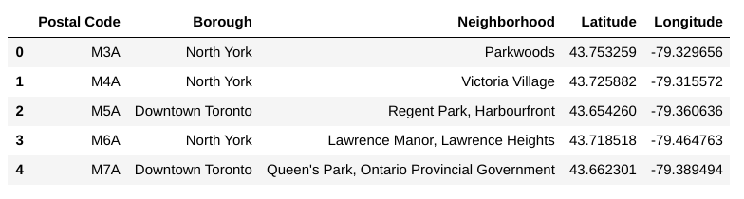
Methodology - Step 1
Data Scraping
Use Pandas to scrape Toronto neighbourhood information from website and online file.

Slide 5
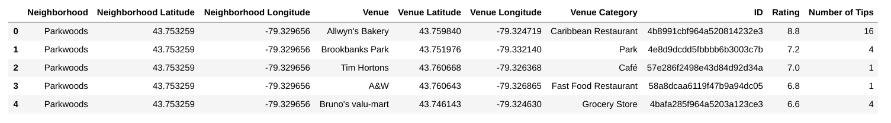
Methodology - Step 2
Acquiring Data from Foursquare
Use Foursquare API to get all the nearby venue information within the radius of 1000m from the center of each neighbourhood.

Slide 6
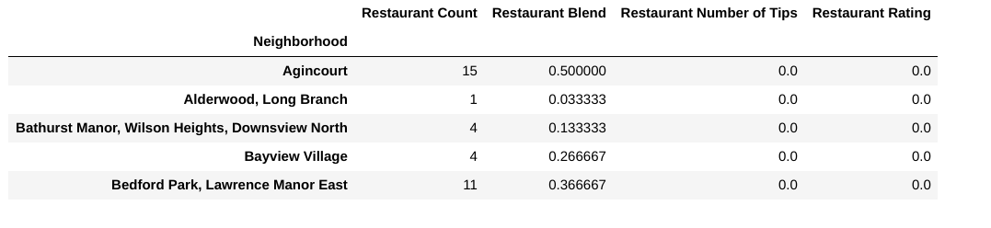
Methodology - Step 3
Data Cleaning and Wrangling
Clean, transform and summarize data in a way that can be processed in K Mean Clustering.

Slide 7
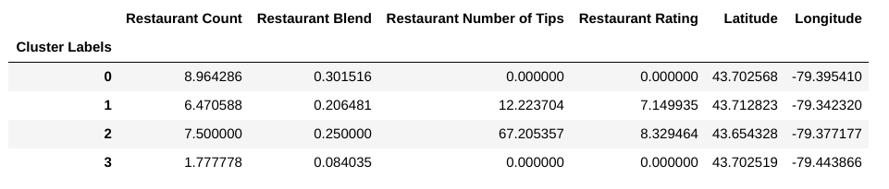
Methodology - Step 4
K Means Clustering
use K Means Clustering method to cluster the neighbourhoods into 4 clusters based on the metrics shown in previous step.

Slide 8
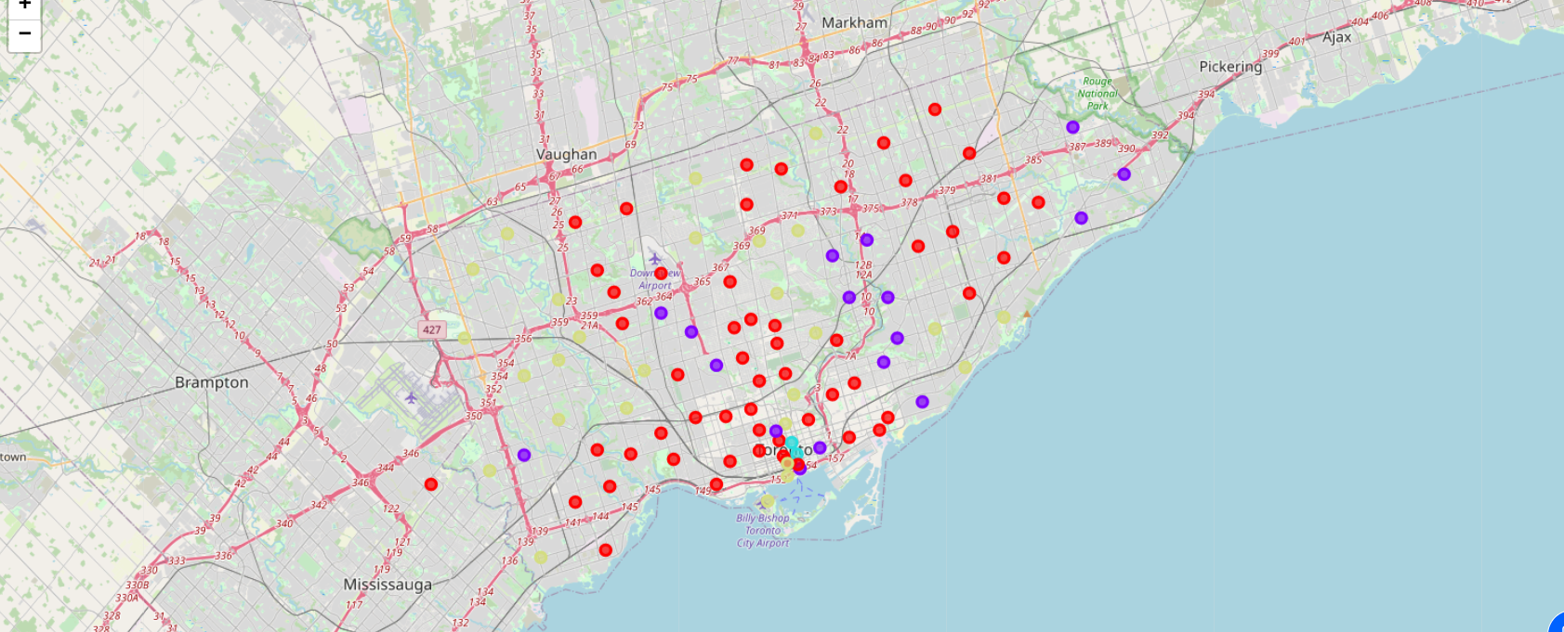
Methodology - Step 5
Data Visualization
Visualize the grouping using Folium

Slide 9
Results
Cluster 0: Neighbourhoods with a decent amount of restaurants but no ratings and tips, indicating that customers have low level of motivation to endorse the restaurants.
Cluster 1: Neighbourhoods with a decent amount of restaurants and average tips amount and rating.
Cluster 2: Neighbourhoods decent amount of restaurants and a high volume of tips and high rating.
Cluster 3: Neighbourhoods with a minimum representation of restaurants. No tips and ratings.

Slide 10
Discussions
Foot traffic and competition are the two most important factors to be considered when selecting restaurant locations. Ideally, we would want to open the restaurant at a place that has a lot of foot traffic and relatively low competition.
Restaurant count: more restaurants mean a high level of competition but also indicate more foot traffic due to the economy of scale effect.
Restaurant blend: higher blends indicate greater competition as most venues fall into the same category.
Restaurant rating: high ratings indicate high qualities of existing restaurants and a higher level of competition
Restaurant number of tips: more tips given by users indicate that customers are more likely to give feedback and recommendations, increasing the online presence of the restaurants.

Slide 11
Conclusions
Cluster 1 and 2 seem to be the most suitable areas to open a new restaurant, with healthy foot traffic suggested by the restaurant count, restaurant blend.
Out of these two clusters, cluster 1 is better than cluster 2 for three reasons:
Restaurants represent lower percentage of all venues in the neighbourhood, which means less competition is present.
Existing restaurants have lower ratings, also suggesting less competition.
Cluster 2 neighbourhoods are located in the center of the city. The prime real estate usually cost more to rent.
Based on the above reasoning, business owners should consider opening new restaurants in neighbourhoods in cluster 1

